Slide 1
Listen and Repeat
[in’t3:pritə] [vou’kǽbjuləri]
[‘prǽktis] [‘dikЅənri]
[‘riəlaiz] [‘nju:mərəs]
[,ould’fǽЅnd] [‘ǣvrid3]
[ri’leitid] [kƏ’miti]
[t^η] [‘nolid3]
[,intə’neiЅn] [‘borou]
[‘waidspred]

Slide 2
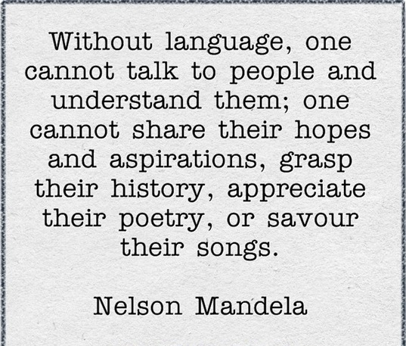

Slide 3
Comment on the quotation
It takes a lot of practice…….
People realize that……..
We need interpreters to………
The knowledge of foreign languages helps…..

Slide 4



Vocabulary revision of the topic ‘English – a language of the world’

Slide 5
Translate from Russian into English
1. Требуется много практики, чтобы выполнить что-то.
It takes a lot of practice to do something.
2. В мире множество языков.
There are numerous languages in the world.
3. Какой твой родной язык?
What’s your mother tongue?
4. Ты никогда не будешь свободно говорить по-английски, если не будешь практиковаться.
You’ll never speak English fluently if you don’t practise.

Slide 6
5. Английский язык – официальный язык Олимпийского комитета.
The English language is the official language of the Olympic Committee.
6. Многие языки заимствуют английские слова и фразы.
Many languages borrow English words and phrases.
7. Я пытаюсь улучшить знания английского, просматривая фильмы и читая книги в оригинале.
I am trying to improve my knowledge of English by watching films and reading books in the original.
8. Его знание языка выше среднего.
His knowledge of the language is above average.

Slide 7


The importance of English
Business and Job opportunities

Slide 8


International Education

Slide 9


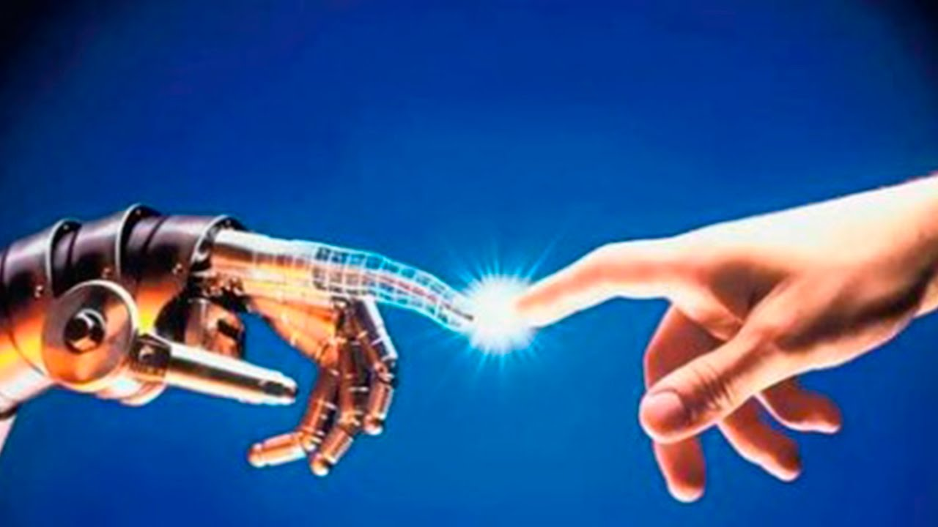
The Information and Technology

Slide 10




Communication

Slide 11


Travelling

Slide 12
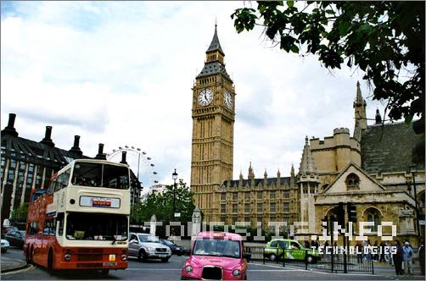

English in my life

Slide 13
Useful phrases
As for me, I think that…..
Personally I believe/ think that…….
In my opinion, English is important for…….

Slide 14
Summing Up. Say ‘True’ or ‘False’
Without language, one cannot talk to people and understand them.
True
English is not widespread.
False
Nowadays educated people should know English.
True

Slide 15
Learning foreign languages will not help you to find a good job.
False
It takes a lot of practice and efforts to learn the language.
True

Slide 16
Self-analysis
Do you know the words on the topic ‘English –a language of the world’? | Can you list the reasons why English is important? | Do you know why you learn English?

Slide 17
Hometask
St.B. ex. 68 p. 59 (in writing)
ex. 70 p. 59 (orally)

Slide 18

Thanks for your attention!

