Slide 1
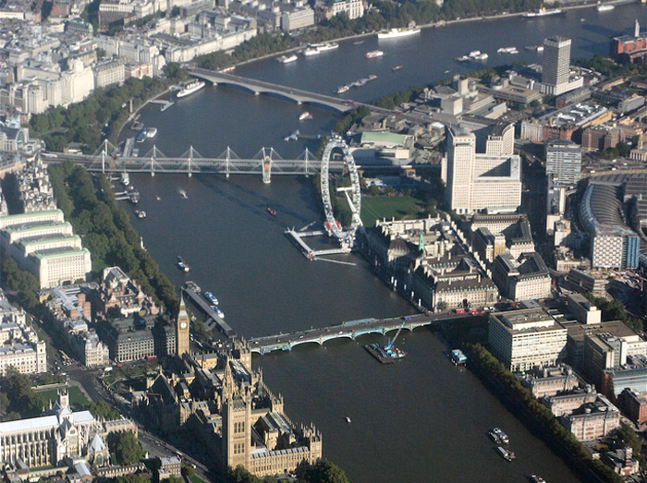
Take a trip along the Thames

Slide 2
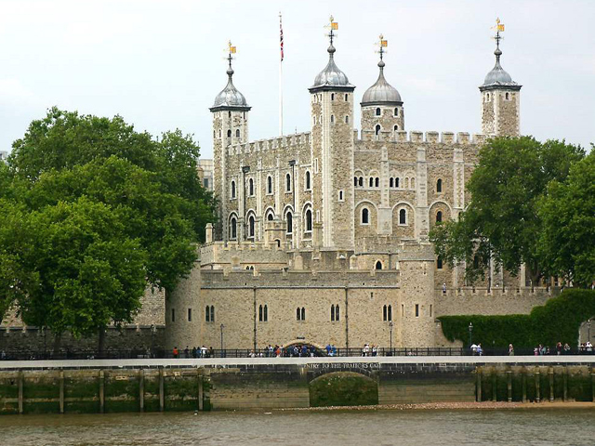
The Tower of London

Slide 3
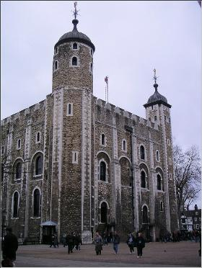
The Tower has served many purposes in the past. It has been a prison, a medieval palace, a fortress and an arsenal. Now it is a museum. It is an amazing place to see it!

Slide 4
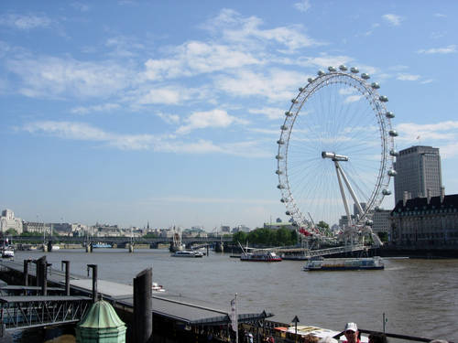
The London Eye

Slide 5
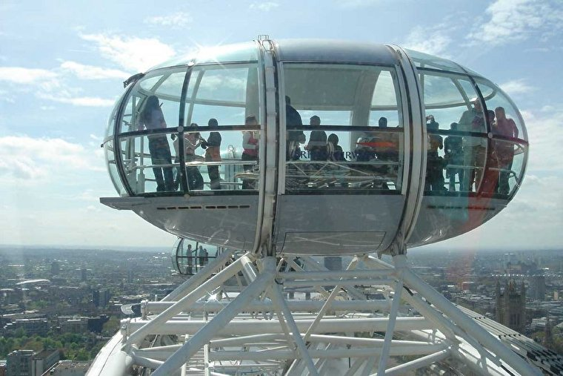
The London Eye is a giant observation wheel situated on the bank of the river Thames. It is 135 meters high. Since opening in March 2000 the London Eye has become a symbol of modern Britain. The big wheel built in 2000 for the millennium.

Slide 6
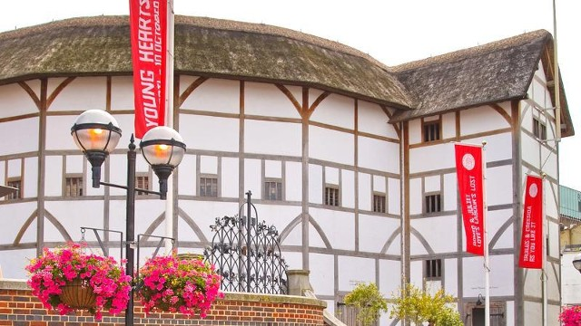
Shakespeare’s Globe Theatre

Slide 7
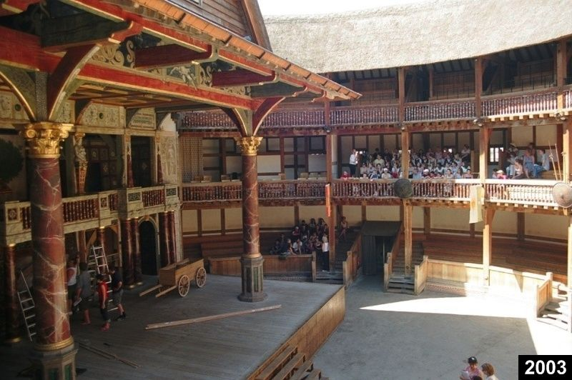
The globe theatre has long been associated with Williams Shakespeare.
The original Globe
Theatre burnt down in a fire started by a cannon which was fired during a performance. The most resent Globe, which was completed in 1997, is not just a theatre. It runs educational workshops and lectures for schools.

Slide 8
What purposes has The Tower served in the past?
Where is the London Eye situated?
Since what time has the London Eye become a symbol of a modern Britain?
With what name is the Globe Theatre associated?

