Slide 1

















MBEI School № 36
Class- 10 “B”

Slide 2

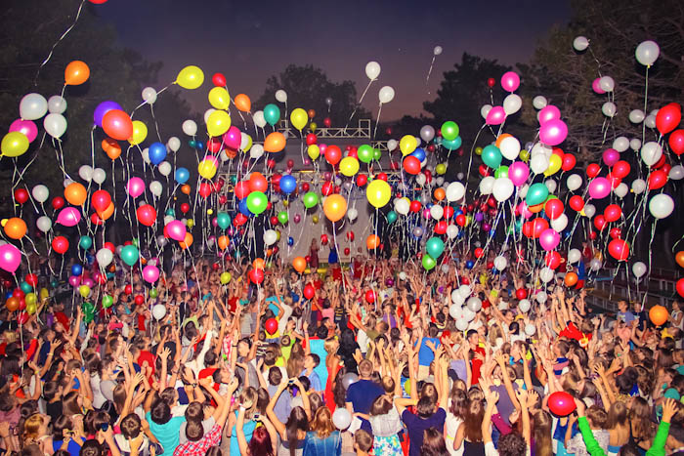






Fun means entertainment
It is:
Music
Games
Books
Places to go
(museums, galleries, cinemas, theatres)

Slide 3

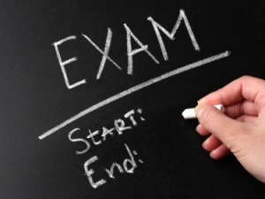
Dear friends! We are inviting you to watch the video with us, then we are going to do some interesting tasks which can be useful for the unified state examination!

Slide 4
На основе просмотренного видеоролика о СМИ в Великобритании, прочитайте данные ниже утверждения и оцените верность суждения, расставив T (True-верно), F (False-неверно), NS (Not stated- в видео об этом ничего не сказано)
1.Two of three British people over the age of 15 read newspapers every day.
1) T 2) F 3) NS
2.In tabloids you will find serious information.
1) T 2) F 3) NS
3.In quality papers you’ll find more news, more serious articles and fewer pictures.
1) T 2) F 3) NS
4.People use different websites to read news on-line.
1) T 2) F 3) NS
5.The BBC is the broadcasting corporation, famous all over the world.
1) T 2) F 3) NS
6.On average British people watch almost 24 hours of TV a day.
1) T 2) F 3) NS
7.It is interesting that in Britain every family has a TV at home.
1) T 2) F 3) NS
This is the end of the task. Check your answers again!

Slide 5
На основе просмотренного видеоролика о СМИ в Великобритании,
закончите фразы, выбрав один из вариантов ответа a, b или c
1) In tabloids papers in Britain you will find
a more curtaining articles
b fewer pictures and serious news
c stories about life and scientific reports
2) The most popular broadsheets contain
a humorous stories about different aspects of British life
b serious information and some pictures
c a lot of adverts, quizzes, celebrity news
3) A great amount of people in Britain
a are using various sites to get information
b don`t buy a newspaper but find news online
c surf the Internet every day

Slide 6
4) The BBC in Britain
a includes advertising during the programmes
b is a broadcasting commercial corporation
c consists of national and local radio stations and some terrestrial TV channels
5) ITV is the British
a independent, commercial TV channel
b well-known advertising TV channel
c TV channel, making films, shows and other entertaining programmes
6) On average British people watch almost 24 hours of TV
a a day
b a week
c a fortnight
7) Most households have
a a TV and a washing machine
b more than two TV sets
c a TV and a video recorder
Remember that:
1 correct answer = 1 point
The maximum number of points is 7
This is the end of the task. Check your answers again!

Slide 7
Life in the Global Village
Прочитайте статью. Распределите предложения A-H по отрывкам текста 1-7. Одно предложение лишнее.
2
5
Is it bad for us? The same survey found that students who watched most TV (and that means over six hours a day!) tended to do worse at school. Perhaps television shouldn`t be blamed, though. Spending your time doing anything instead of studying is probably going to affect your performance at school. (Oh, by the way, experts agree that your eyes won`t be damaged by watching TV, so you can cross that one off the list of bad effects!)
Well, one thing we do with it is forget it. Almost all the facts, figures and faces that we see on our TV screens are instantly forgotten. There`s just too much information for us to deal with. In a real village, we might know and care about the problems of a few hundred people. In the global village, there are six billion people, each with their own problems, ideas and points of view. It`s not surprising that a lot of the information that we receive is just ignored.
A There`s more to come and we need to be able to deal with it.
B It`s hard to understand so much information.
C Bad effects might not be the fault of what we watch.
D Too much TV can have serious consequences on your health.
E The amount of contact means that the world doesn`t seem so big.
F We have a large choice of different things to watch.
G TV helps us understand the problems faced by people around the world.
H Most teenagers watch TV a lot.
3
6
What are TV`s other effects? We live in that has been called `the global village`. Sounds a bit strange to call the world `a village`, but it makes sense. It`s just as easy to find out what`s happening on the other side of the world as at the end of your street. As telecommunications have developed, the world has got smaller and smaller. Television has come to dominate the world, bringing an incredible and sometimes confusing, stream of images into our homes.
At the same time, we are taught a huge amount by our televisions. Do you know that the bottom of the ocean looks like? Do you understand how poor people in Africa or India feel? The images that are broadcast to us through television show us things that our grandparents probably never knew about. That means we understand the world and the problems we face together more than ever before.
1
4
7
Like most of us, you probably watch television. In fact, you probably watch a lot of television. In one survey, it was found that American adolescents watch an average of twenty-seven hours of television a week. That`s about four hours a day, every day! And you can be sure they aren`t watching educational documentaries!
We now have more channels to choose from than ever before. Satellites have been put into space to beam programmes down to us and cables have been put underground to bring us news and entertainment. We can get the headlines immediately from all four corners of the Earth, keeping us up to date with what`s happening. So, what do we do with all that information?
What does the future hold? We can expect more channels, more satellites, more news. The amount of information we receive each minute can only go up. What we need to do is learn to select the information that is important to us. We can turn over, or turn the TV off, but we can`t stop its effects on our lives.

Slide 8

Check your answers!
1 | H
2 | C
3 | E
4 | F
5 | B
6 | G
7 | A
Remember that:
1 correct answer = 1 point
The maximum number of points is 7

Slide 9
Прочитайте приведенный ниже текст. Образуйте от слов, напечатанных заглавными буквами в конце строк, обозначенных номерами 1-10, однокоренные слова так, чтобы они грамматически и лексически соответствовали содержанию текста. Занесите слова в бланк с ответами.
Soap operas
Although many of us CRITICISE them and regard them as poor (1) ……………. , soap operas still remain very popular.
Millions of people rush home from work in order to watch the latest episode, and get very upset if they miss one.
The (2) ……………… , is that even the worst soap can become addictive after just a few episodes. There are many reasons for this.
One of them is (3) ………….. because we can understand the problems which the characters encounter and the (4).................
which they have and express.
This (5).................... connection which we feel may be due to a character being similar to us (6) ………… . Sometimes, however, characters are very different to us, but we still relate them. Why is this?
The answer is quite (7) ………….. . Often, we admire characters who we want to be like, but aren`t. Strangely, though, we also often like a character whose (8)............... is bad or antisocial but who still manages to be (9) ………….. . This seems to be a kind of escape from the real world of us. The character is not punished in the show, but we (10)...................
that if we did the same, we would be punished.
CRITIC
ENTERTAIN
TRUE
PROBABLE
FEEL
PSYCHOLOGY
PERSONAL
INTEREST
BEHAVE
SUCCEED
BELIEF
This is the end of the task. Check your answers again!

Slide 10

Check your answers!
1 | ENTERTAINMENT
2 | TRUTH
3 | PROBABLY
4 | FEELINGS
5 | PSYCHOLOGICAL
6 | PERSONALLY
7 | INTERESTING
8 | BEHAVIOUR
9 | SUCCESSFUL
10 | BELIEVE
Remember that:
1 correct answer = 1 point
The maximum number of points is 10

Slide 11
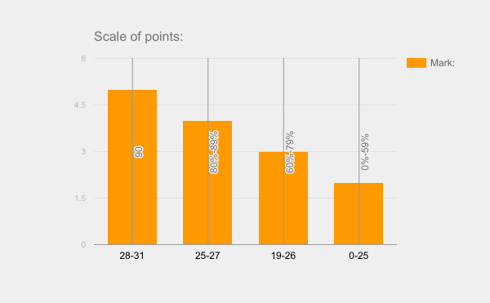
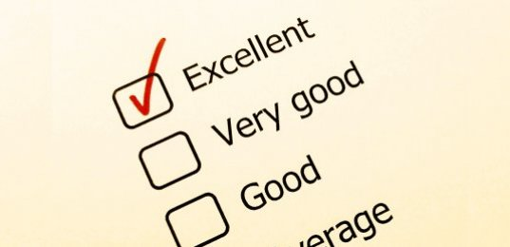
Work evaluation scale:
28-31 points- 90% and above - “5” (Excellent)
25-27 points- 80% - 89% - “4” (Good)
19-26 points- 60%- 79% - “3” (Satisfactory)
0-25 points- 0%-59% - “2” (Bad)

Slide 12
Teacher:
Chulina Natalia Alexandrovna
Pupils:
Prokhorova Daria
Kukhorev Vitaly
Tyurina Ekaterina
Glazko Anastasia
Averyanova Julia
Sayyan Anastasia
Panin Daniil
Maslennikova Tatyana
Kartashova Anastasia
Zhovty Anatoly
Selitsky Vladimir

Slide 13


Thank you very much for your attention! Perhaps, we will have a new meeting next time…
We hope that you have enjoyed our lesson!

