Slide 1
krfolmbwdfpoianbwkdlopetszapnqetywuytрnplkhsdgardeningmxdeoiqqakdtheatrempekfrjuznbverjbclkswfmusickqweifjrhyclkmqhdenufnblkjsrtlqwemzncollectinglwqkvmnrdlkritnvlpeorijnnbalwemncookinglqw
lwmjhhikingpqterganbxiekldsaoiurartkwqlepomckdlkpemwcckqaemh

Slide 2
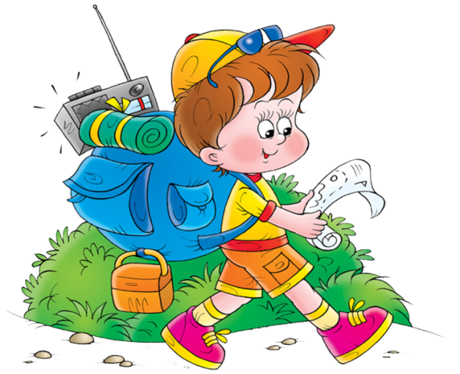
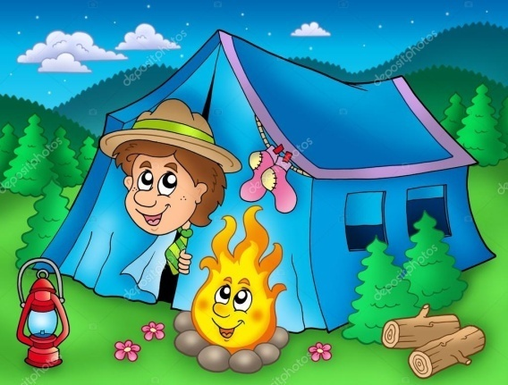
Going hiking
picturesque places
out
mountains
a landscape to the full
the countryside change
a lot of time in the open air
the door of nature’s secrets
mysteries of plants
birds and animals
unlock
examine
watch (2)
enjoy (2)
spend
sleep
climb

Slide 3
Going hiking
……….., a lot of people like hiking ……………….. they spend a lot of time in the open air which is very healthy. They unlock the door to nature’s secrets, enjoy picturesque places …………. watch the country change. ……………………, tourists can climb mountains, ………….. , they have a chance to enjoy the landscape to the full. …………………. , people watch birds and animals …………. examine mysteries of plants. ……………………. , it’s fun to sleep out!

